Slide 1


E-Learning
Platform
A Scalable Web Application using Java, Spring Boot, and MySQL
Presented By:
Kottapalli Sreevatsa

Slide 2


Introduction
This project is a modern e-learning platform designed to provide a seamless and interactive educational experience.
It addresses the growing need for accessible, flexible, and robust online learning systems. By leveraging the power of the Java Spring Boot framework, it aims to deliver a secure, scalable, and maintainable solution for students and instructors alike.

Slide 3
Project Objectives
Centralize Learning: To create a single, unified platform for students and instructors to manage and access course content.
Ensure Security: Implement robust user authentication and authorization for different roles (Student, Instructor, Admin).
Build a Scalable System: Utilize Spring Boot and MySQL to create a high-performance, scalable backend architecture.
Enhance User Experience: Design a user-friendly and responsive interface with HTML & CSS for easy navigation and interaction.

Slide 4
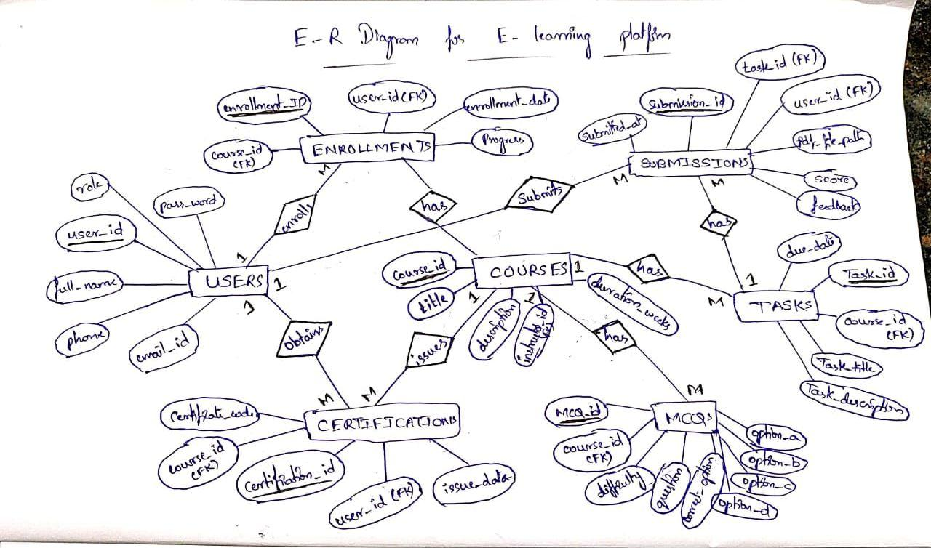
Entity - Relation (ER) DIagram

Slide 5
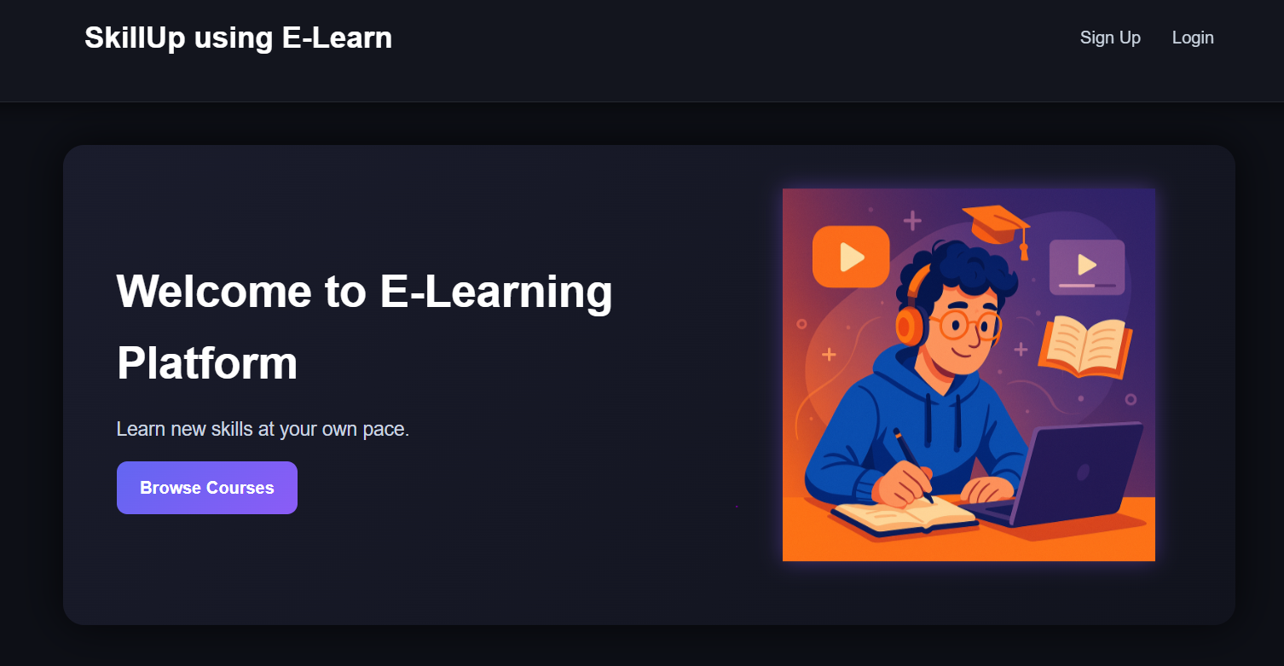
OUTPUT

Slide 6
Technology Stack
The core technologies used to build the platform.

Slide 7






Technology Stack
Frontend
Backend (Spring Boot)
Database
HTML5 and CSS3
(With Thymeleaf templates) for building a responsive, multi-device, and user-friendly interface.
MySQL as the relational database for persistent storage of users, courses, and progress. Managed via Spring Data JPA.
Java Spring Boot for robust REST APIs, business logic, and security..

Slide 8


Platform Features
Core Features Added
Features to be Upgraded
Multi - Role User Authentication (Student, Instructor)
Advanced User Dashboard
Content Delivery Module (e.g., Videos, PDFs, Notes etc.,)
Student Enrollment
Automated Certificate Generation
Course Enrollment & Course Catalog
Task Submission System
Student Dashboard & Profile
Instructor Dashboard Handling Student Details
MCQ Quiz System
Security Enhancements

Slide 9
Future Directions & Scope
Mobile Application
Advanced Analytics
Develop native Android and iOS apps for a seamless mobile learning (m-learning) experience.
Build a data analytics module for instructors to track student performance in detail.
AI Personalization
Payment Gateway
Implement an AI engine for adaptive learning paths and personalized course recommendations.
Integrating a Payment Gateway will transform this platform to a Full-featured Commercial E-Learning Marketplace

Slide 10



Where It Can Be Implemented
Corporate Training
Educational Institutions
Commercial Academies
Onboarding new employees and upskilling existing teams within an organization.
Supplementing in-class learning for schools and universities (blended learning).
Creating a public marketplace for private tutors and professional certification programs.

Slide 11
Conclusion
This Java-based e-learning platform provides a scalable, secure, and feature-rich foundation for the future of online education.
"
"

Slide 12
THANK YOU
Any Questions?

